Slide 1
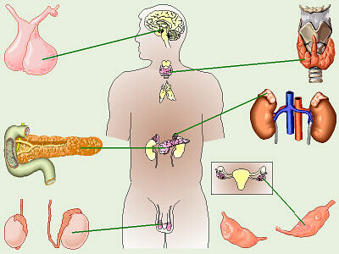
THE ENDOCRINE SYSTEM
GLANDS IN YOUR BODY

Slide 2
Where do you think glands in your body are located?
Eyes
Under arms
Neck

Slide 3
What do you think glands release?
Sweat, tears & saliva
Hormones: which help the body work and grow

Slide 4
How are hormones released into the body?
Circulatory and immune systems
Hormones are important during puberty

Slide 5
What happens when your body releases too little or too many hormones?
Your growth and development is affected.

Slide 6
HORMONE
A hormone is a chemical released from an endocrine gland that is carried by the circulatory system to a target organ where it elicits a change in structure or function.
The Inside Story with Slim GoodBody

Slide 7
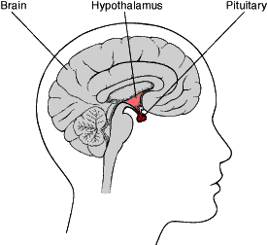
Pituitary Gland
Location: base of skull
Hormone: growth
Effect:
Growth of long bones
Milk production
Stimulates thyroid
Water balance

Slide 8
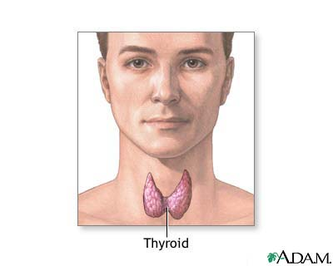
Thyroid Gland
Location: Neck
Hormone: Thyroid stimulating
Effect: Increase Metabolism

Slide 9
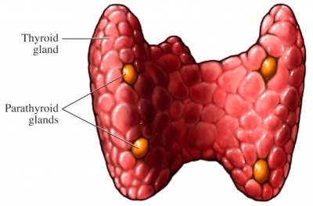
Parathyroid Gland
Location: back of neck
Hormone: Calcitonin
Effect:
Stores and releases calcium

Slide 10
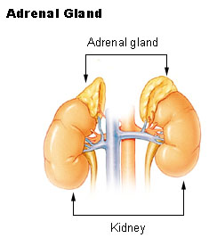
Adrenal Gland
Location: top of kidney
Hormone: Epinephrine
Effect:
Speeds up metabolism
Salt and water balance

Slide 11
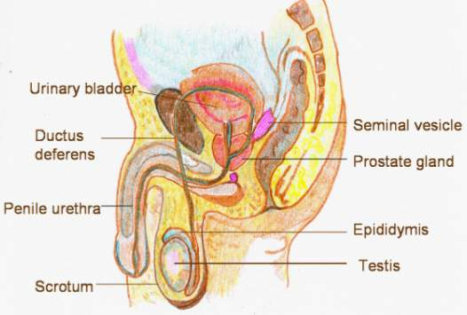
Testes
Location: male groin area
Hormone: Testosterone
Effect: Sperm production

Slide 12
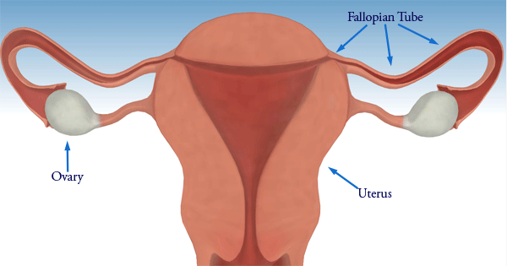
Ovaries
Location: Female abdomen
Hormone: Estrogen & Progesterone
Effect:
Egg Production
Uterine Lining

Slide 13
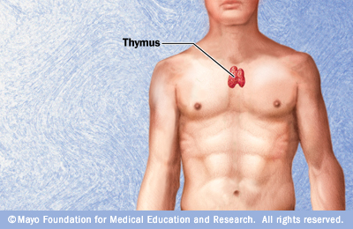
Thymus Gland
Location: Above the heart
Hormone: Thymosin
Effect: T-cell production*
* t-cells are a type of white blood cells that protect your body from infection

Slide 14
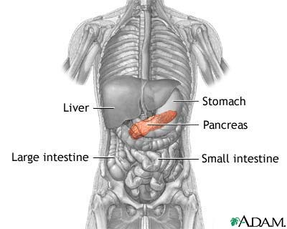
Pancreas
Location: Mid-line behind the stomach
Hormone: Insulin & Glucagon
Effect: Stores glucose & releases glycogen*
*both glucose and glycogen are carbohydrates that your body uses to create energy

