Slide 1
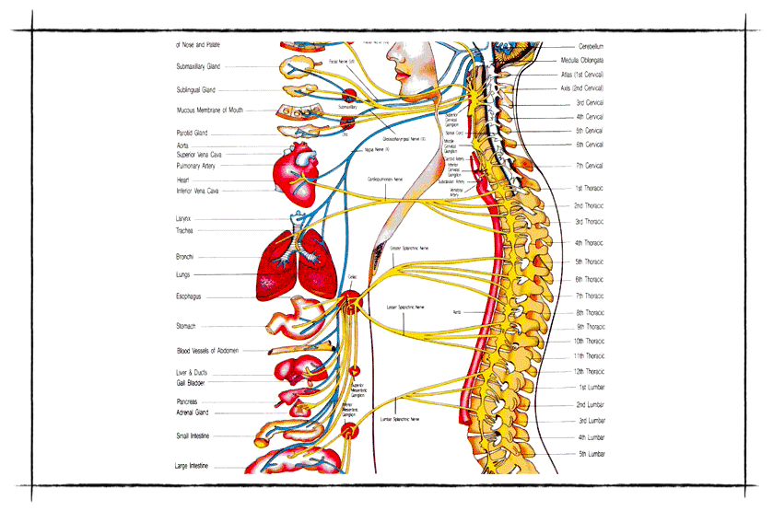
Nervous System

Slide 2
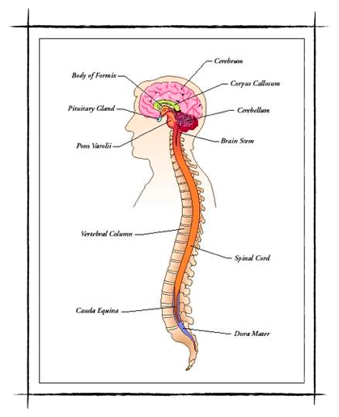
Functions
gathers & interprets information
responds to the information

Slide 3
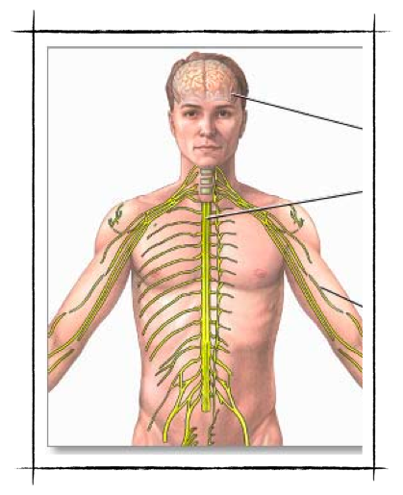
Two Parts
Central Nervous System (CNS)
Peripheral Nervous System (PNS)

Slide 4
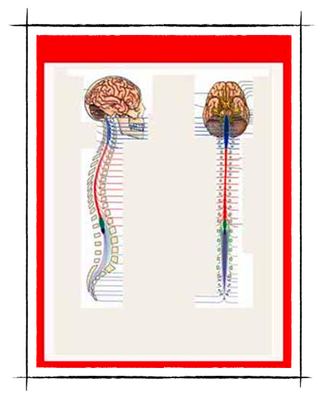
Organs of CNS
brain
spinal cord

Slide 5
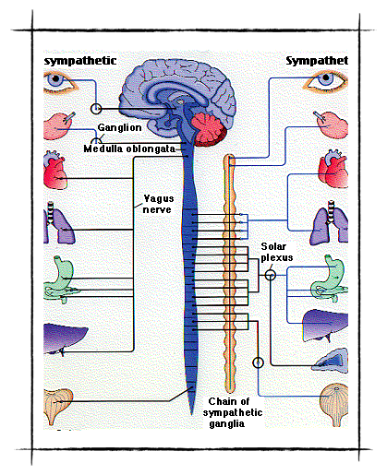
Organs of PNS
all other parts of nervous system
nerves

Slide 6
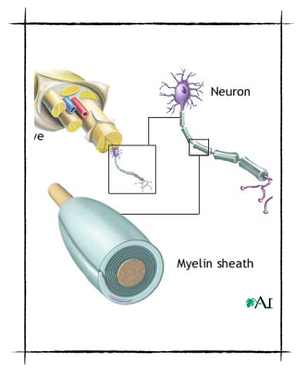
The Peripheral Nervous System
What is a nerve?
collection of axons bundled together with blood vessels and connective tissue

Slide 7
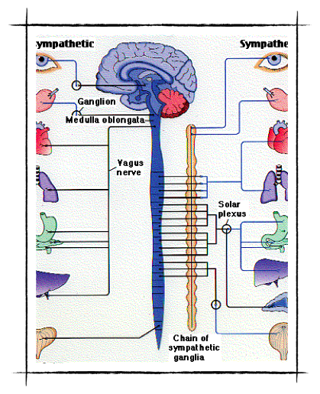
Parts of the PNS
Somatic Nervous System
Autonomic Nervous System
Read page 229

Slide 8
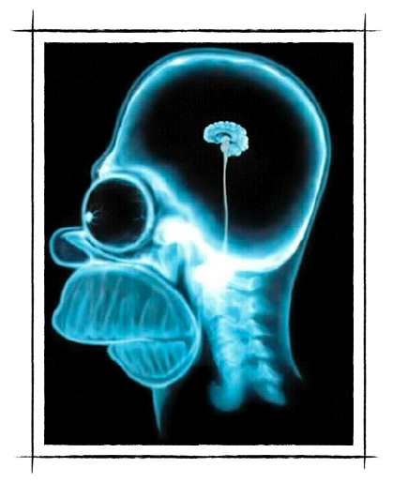
The Central Nervous System
BRAIN
control center for the body
each region associated w/ specific functions

Slide 9
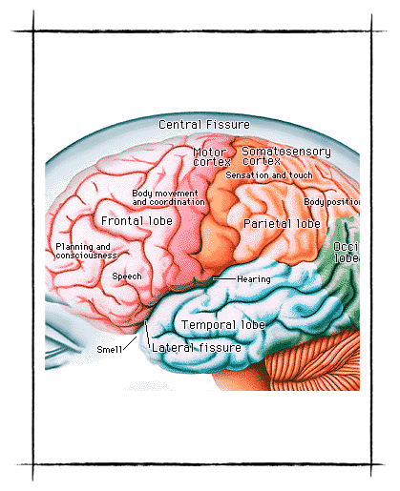
CEREBRUM
divided into right and left hemispheres
conscious functionings
interpreting stimuli from senses

Slide 10
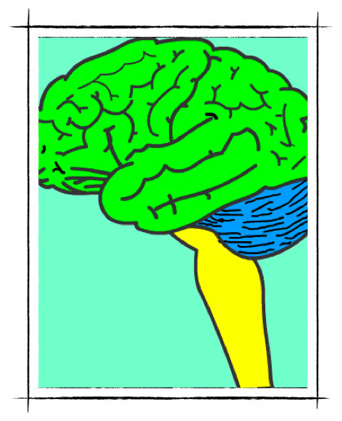
CEREBRUM
sensory detection
motor control of skeletal muscles

Slide 11
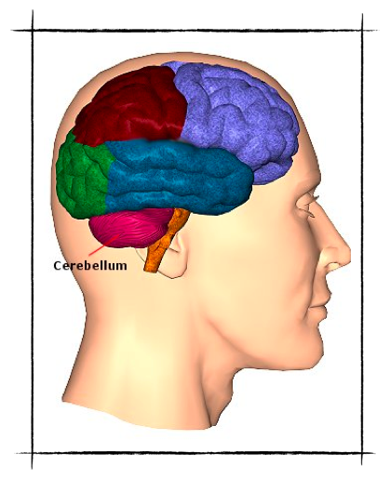
CEREBELLUM
second largest portion
fine motor coordination
body movement
posture
balance

Slide 12
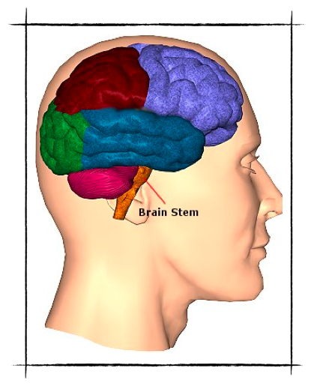
BRAIN STEM
parts:
medulla oblongata
pons
midbrain

Slide 13
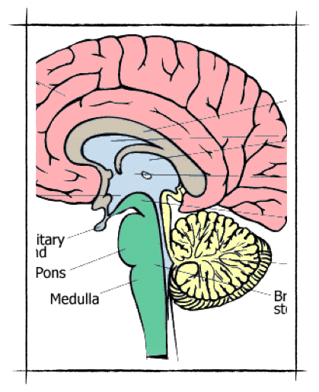
BRAIN STEM
controls:
heart rate
constriction of blood vessels
digestion
respiration

Slide 14
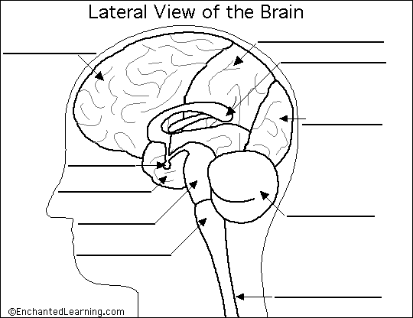

Slide 15
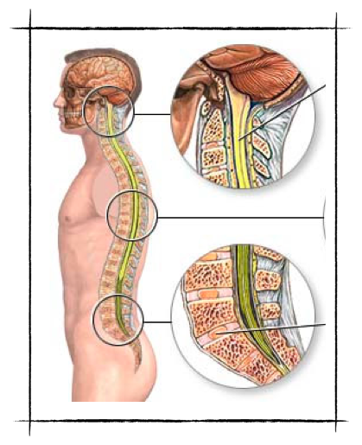
SPINAL CORD
bundle of interneurons
surrounded by the vertebral column
cranium to hip area

Slide 16
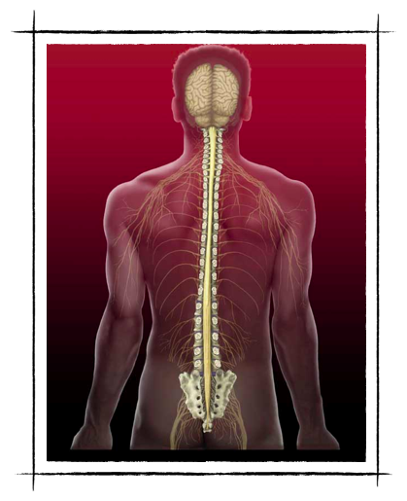
SPINAL CORD
provides connection b/w the brain and the extremities & region of the body associated with reflex actions

